Slide 1

Donald A Wilson Secondary School
Boundary Review – Virtual Public Meeting
March 8, 2022

Slide 2

Agenda & Process – March 8, 2022 Virtual Public Meeting
Agenda:
  Land Acknowledgement
  Presentation -- 2 options provided for consultation & Input to date
  Community Questions & Answers
  Wrap up
Process:
  Please use the Q&A button to type in your questions for everyone to view
  DDSB staff will use best efforts to respond within the Webinar either by messaging through the Q&A or responding live
    Feel free to “like” a question using the Thumbs Up button
  All input received will be included in the Final Recommendation Report to the Board of Trustees for consideration on April 19, 2022

Slide 3
Land Acknowledgement
The Durham District School Board acknowledges that many Indigenous Nations have longstanding relationships, both historic and modern, with the territories upon which our school board and schools are located. Today, this area is home to many Indigenous peoples from across Turtle Island. We acknowledge that the Durham Region forms a part of the traditional and treaty territory of the Mississaugas of Scugog Island First Nation, the Mississauga Peoples and the treaty territory of the Chippewas of Georgina Island First Nation. It is on these ancestral and treaty lands that we teach, live and learn.
This statement was co-created in partnership with the Mississaugas of Scugog Island First Nation and the Chippewas of Georgina Island.

Slide 4

Overview
An information report on the proposed boundary review for Donald A Wilson Secondary School was presented to Trustees at the February 22, 2022, Board Meeting.
  The purpose of the report was to initiate the consultation process and gather community input on the proposed boundary change options that affect both the Regular and French Immersion (FI) programs at Donald A Wilson SS.
The Board Report, PowerPoint presentation, School Newsletter and a survey were posted to the Board website and are accessible through the affected schools’ websites (Donald A. Wilson SS, Anderson CVI, Sinclair SS, John Dryden PS, Julie Payette PS, Ormiston PS and Robert Munsch PS and the elementary and secondary Virtual Schools) .
Staff will collect feedback through email at DAWSSBoundaryReview@ddsb.ca, phone 905-436-5098 & survey at: https://www.surveymonkey.com/r/DAWboundary2022-23 until March 23, 2022. All input will be summarized in the April 19, 2022, Recommendation Report to Trustees.

Slide 5

Boundary Review Initiation
Donald A Wilson SS (DAWSS) is experiencing enrolment pressures resulting from the increased demand for French Immersion program and from new housing development in the area.
For the 2022-23 school year, it is projected to operate at 153% utilization if all students are attending in-school learning (projections include students attending in-school learning and virtual learning).
Enrolment pressure is projected to increase over time as set out on the following slide.
The school currently has 19 portables on site but only 18 can be used for classroom instruction. The site can only accommodate a maximum of 22 portables.
Even with additional portables, the school would face significant enrolment pressures while exceeding the washroom capacity and available parking would be insufficient.
Program scheduling in specialized spaces (i.e., Gymnasia, Cafeteria) is a concern when trying to meet the needs of all students.
The safety issues given the sheer number of students currently attending in-school classes will only increase for the coming September based on early projected enrolments

Slide 6

Boundary Review Initiation -- Cont’d

Slide 7

School Community Concerns
    Overcrowding at Donald A Wilson SS has resulted in traffic congestion as students are dropped off and picked up.
    The cafeteria cannot accommodate all students being on lunch at the same time. The school has, as a result, expanded to two lunch periods.
      Four periods are needed to keep the number of students in a lunch period at a manageable level; however existing restrictions make this challenging.
    The safety issues given the sheer number of students currently attending in-school classes will only increase for the coming September based on early projected enrolments

Slide 8

Proposed Solution
For the 2022-23 school year, relocate a portion of the students at DAWSS who currently reside within the following attendance boundary areas as follows:
  French Immersion program – John Dryden PS and Julie Payette PS to Anderson CVI to create a new French Immersion program;
  Students currently in Grade 8 attending the French Immersion programs at John Dryden PS and Julie Payette PS would attend the French Immersion program at Anderson CVI instead of the French Immersion program at DAWSS ;
  Regular program – Ormiston PS and Robert Munsch PS to Sinclair SS;
  Students currently in Grade 8 attending the Regular programs at Robert Munsch PS and in the holding area attending Ormiston PS would attend Sinclair SS instead of the Regular program at DAWSS.
More details about the two proposed options for consultation are provided in the following slides.
  The two options consider the same boundary revisions; however, the number of students impacted varies depending on the option. Students attending Virtual Schools have been included in the enrolment projections.

Slide 9
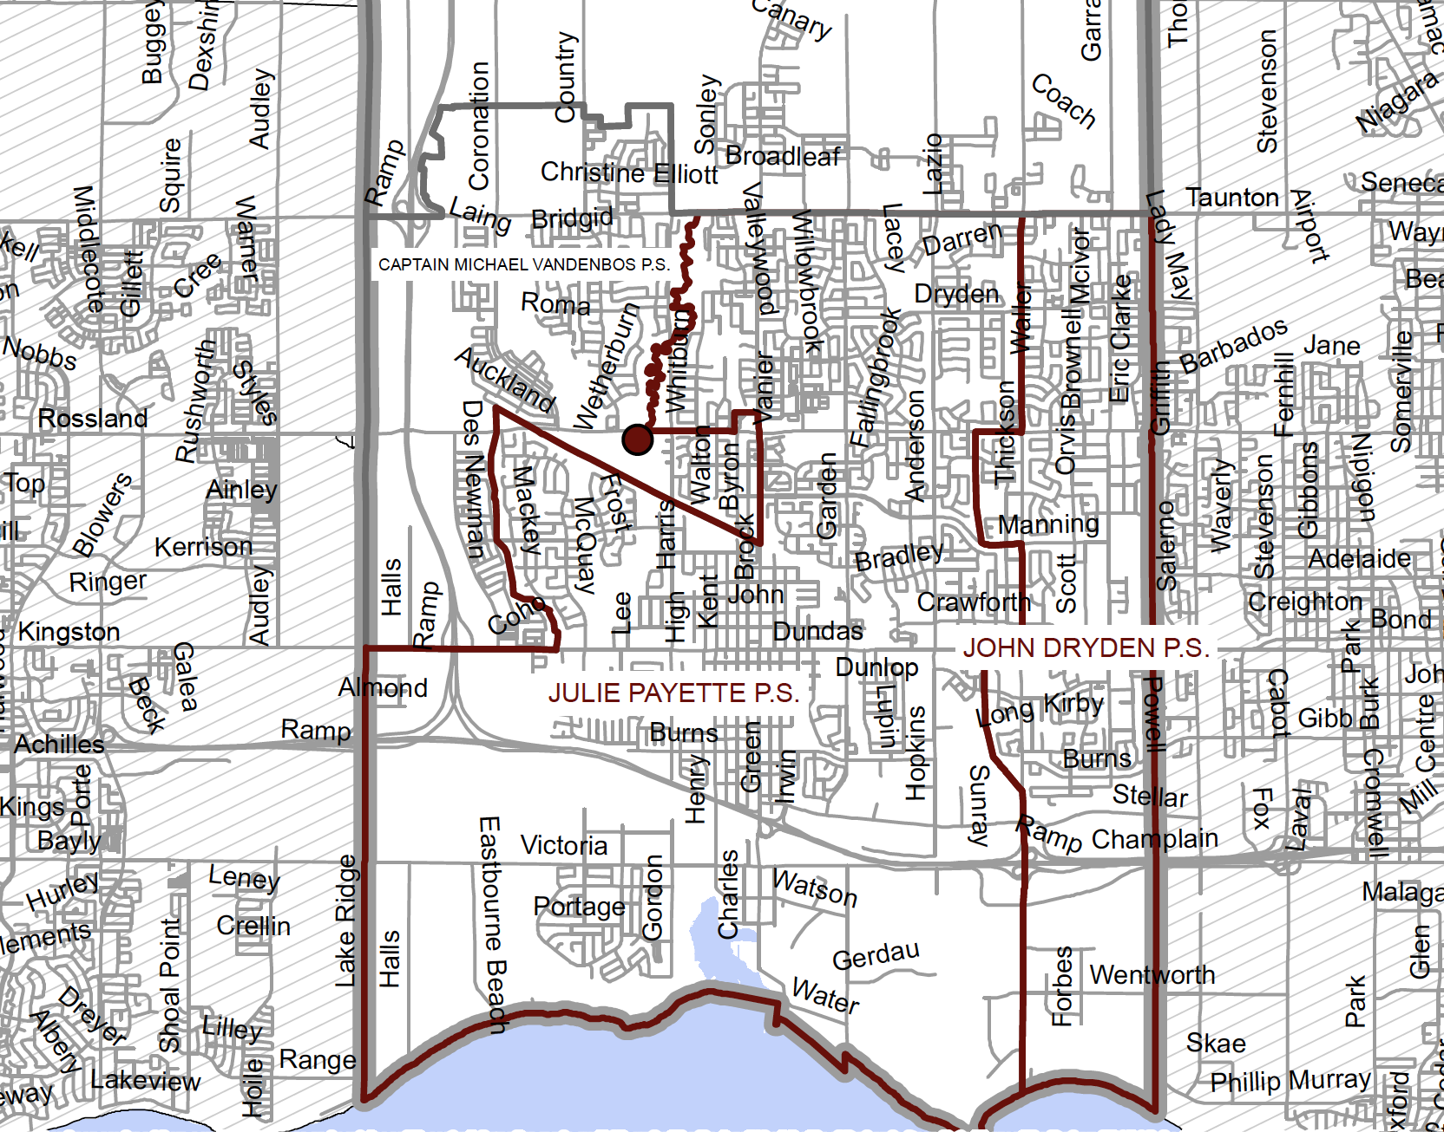
Existing FI Boundary – Donald A Wilson SS

Slide 10
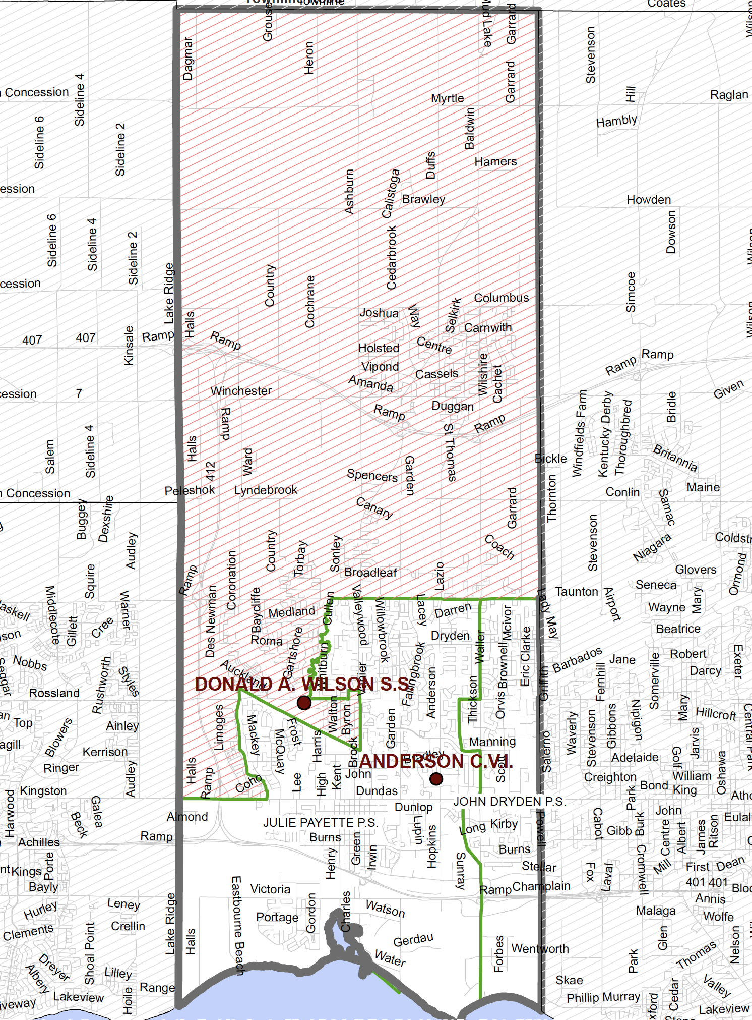
Proposed FI Boundary – Donald A Wilson SS and Anderson CVI

Slide 11
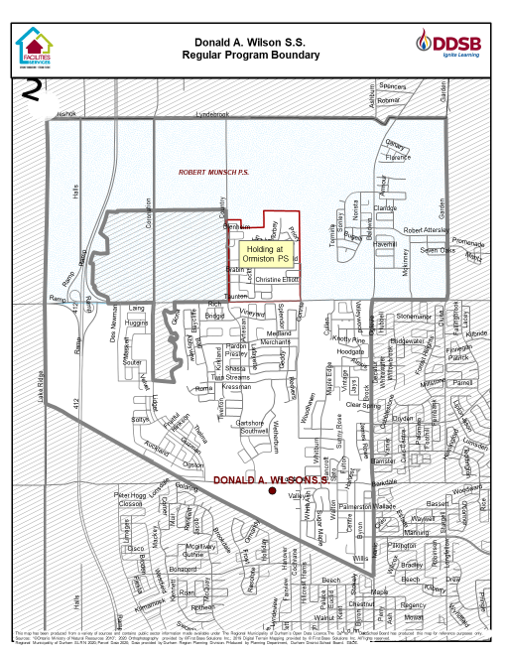
Existing Regular Boundary – Donald A Wilson SS

Slide 12
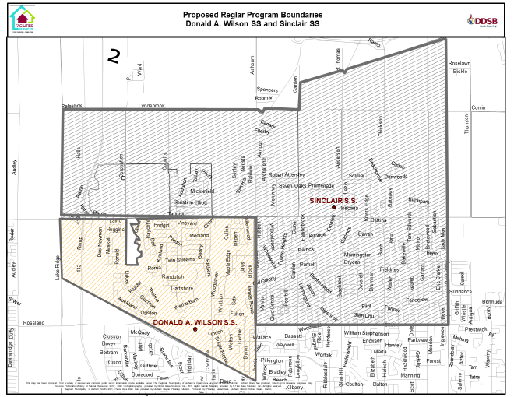
Proposed Regular Boundary – Donald A Wilson SS and Sinclair SS

Slide 13
Option 1 – Grades 8 and 9
  Over the 6-year projection period, on average, approximately 37% of the FI program at Donald A Wilson SS would be relocated to Anderson CVI to develop a new FI program through the redirection of:
    Grade 8 students holding at Julie Payette PS and John Dryden PS FI feeder schools to Anderson CVI for Grade 9 in the FI program;
    The 2021-22 DAWSS FI program Grade 9 class of students that reside within the Julie Payette PS and John Dryden PS FI feeder school boundaries to Anderson CVI.

Slide 14
Option 1 – Grades 8 and 9 – Cont’d
  Over the 6-year projection period, on average, approximately 20% of the Regular program at Donald A Wilson SS would be relocated to Sinclair SS through the redirection of:
    Grade 8 students that reside within the Robert Munsch PS and holding students from Ormiston PS feeder schools to Sinclair SS for Grade 9 in the Regular program;
    The 2021-22 DAWSS Regular program Grade 9 class of students that reside within the Robert Munsch PS and the holding area attending Ormiston PS feeder school boundaries to Sinclair SS.

Slide 15
Option 1 – Impact – Donald A Wilson SS

Slide 16
Option 1 – Impact -- Anderson CVI

Slide 17
Option 1 – Impact -- Sinclair SS

Slide 18
Option 2 – Grades 8, 9 and 10
    Over the 6-year projection period, on average, approximately 40% of the FI program at Donald A Wilson SS would be relocated to Anderson CVI through the redirection of:
      Grade 8 students that reside within the Julie Payette PS and John Dryden PS FI feeder school boundaries to Anderson CVI for Grade 9 in the FI program;
      The 2021-22 DAWSS FI program Grade 9 and Grade 10 classes of students that reside within the Julie Payette PS and John Dryden PS FI feeder school boundaries to Anderson CVI.

Slide 19
Option 2 – Grades 8, 9 and 10 – Cont’d
    Over the 6-year projection period, on average, approximately 22% of the Regular program at Donald A Wilson SS would be relocated to Sinclair SS through the redirection of:
      Grade 8 students that reside within the Robert Munsch PS boundary and holding students from Ormiston PS feeder schools to Sinclair SS for Grade 9 in the Regular program;
      The 2021-22 DAWS Regular program Grade 9 and Grade 10 classes of students that reside within the Robert Munsch PS and holding students from Ormiston feeder school boundaries to Sinclair SS.

Slide 20
Option 2 – Impact – Donald A Wilson SS

Slide 21
Option 2 – Impact -- Anderson CVI

Slide 22
Option 2 – Impact -- Sinclair SS

Slide 23
Transportation & Staffing
  Durham Student Transportation Services (DSTS) identify safe walking routes for all schools.
    Utilizing the DSTS Transportation Policy, DSTS identifies a walk-out of a distance up to 3.2 kilometers based upon the shortest route on the road network, including municipal walkways.
  Durham Student Transportation Services has not yet determined the impact, if any, on the number of buses that will be required for the affected areas within the redefined attendance areas for Donald A Wilson SS, Anderson CVI and Sinclair SS. This will be determined should the boundary realignment be approved.
  As a result of the current restrictions, the 2022-2023 school year staffing process has been delayed for the system. As such, staffing resulting from the proposed boundary realignment would be addressed in a timely manner for the 2022-2023 school year.

Slide 24
Input Received to Date
Are all elementary students residing in the identified elementary boundaries of Robert Munsch, Ormiston (holding), Julie Payette and John Dryden impacted by the proposed change?
  Response: Yes, if the Board of Trustees approve this, the elementary students (residing in the school boundaries identified above ) will be affected as their secondary school designation would change.
Would the expansion of a new FI program to Anderson CVI provide equivalent course offerings as students currently have?
  Response: Course offering will be dependent on the number of students; course selection availability and staff.
Would the Board consider establishing an FI program at Brooklin HS?
  Brooklin HS does not have available space to accommodate an FI program.
Something needs to be done to alleviate the enrolment pressures at Donald A Wilson SS.
  Response: Should the Board of Trustees approve one of the Staff Recommended Options in the ongoing Boundary Review, the enrolment pressure at the school would decrease and there would be better use of available space at Sinclair SS and Anderson CVI.

Slide 25
Input Received to Date
Don’t move the Grade 10 students identified as impacted by this Boundary Review from Donald A Wilson SS.
  Response: Moving the current Grade 8, 9 and 10 students is Option 2 under this Boundary Review. Option 1 seeks community input on moving only the current Grade 8 and 9 students.
All three schools, Donald A Wilson SS, Anderson CVI and Sinclair SS will be operating at capacity or with portables if you proceed with either of these options.
  Response: Either of the proposed options would result in all three facilities having better use of existing space while reducing the enrolment pressure at Donald A Wilson SS.
There will be increased traffic congestion at all of the schools
  Response: Should either proposed option be approved by the Board of Trustees, it is expected that the traffic flow at Donald A Wilson SS would decrease while traffic flow at the Anderson CVI and Sinclair SS would increase; however, the enrolment pressure at Donald A Wilson SS would decrease. Traffic congestion could be offset through the use of bussing or students walking to school.

Slide 26
Wrap Up
Thank you all for your participation!
Your input is invaluable to the DDSB and will be included in the Final Recommendation Report to be submitted to the Board of Trustees on April 19, 2022
At the April 19, 2022, Board Meeting, the Trustees will be considering the staff recommendation.
Should the Trustees approve the staff recommendation, the implementation of the realigned boundaries would be effective September 2022.
Continued Input is always welcomed and staff will collect feedback until March 23, 2022, via:
  email at DAWSSBoundaryReview@ddsb.ca
  phone line (905-436-5098)
  Survey at: https://www.surveymonkey.com/r/DAWboundary2022-23

