Slide 1
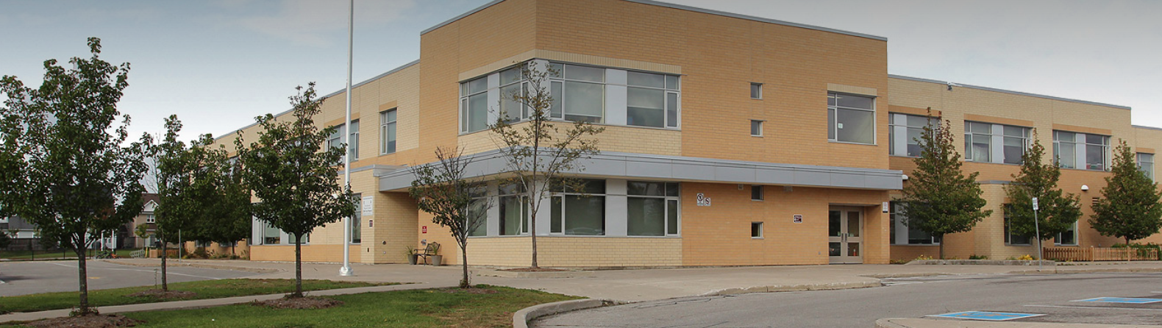
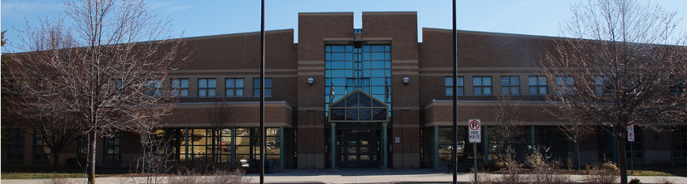
Education Development Charges
Joint Successor By-law Public Meeting
QUADRANT ADVISORY GROUP & PSTGI
Durham DSB and Durham Catholic DSB
February 28, 2024

Slide 2
Overview of Education Development Charges
EDCs may be imposed by school boards who qualify on the basis of:
  Either average enrolment will exceed capacity over 5-year by-law period, or
  The board has a deficit in the EDC account the day prior to the successor by-law being enacted, and has outstanding financial commitments
EDCs pay for the costs to acquire and develop land necessary to accommodate additional pupil places generated by new housing development
EDCs are based on projections and estimates. Legislation was intentionally silent on a number of aspects of the calculation. The biggest challenge is to defensibly interpret the legislation given changing land development practices
From 1998 to March 2019, the EDC scheme was designed to derive precisely the value of the net growth-related land needs (including financing and study costs) – not a penny more; not a penny less. School boards do not have access to the tax base and ‘Land priorities’ funding not to be used to fund growth-related site needs. There is currently no funding source for any unmet growth-related land costs. However, boards may consider Alternative Projects as a means of reducing education land costs, subject to the Minister’s approval
The EDC calculated rate is based on the total net education land costs divided by the ‘net’ new units and ‘net’ non-residential GFA (net of statutory exemptions)
EDCs are paid at the time a building permit is issued and collected by the jurisdictional municipalities’ building departments, then forwarded to the Durham Boards on a monthly basis
QUADRANT ADVISORY GROUP & PSTGI

Slide 3
EEDC Successor By-law Consideration
Durham boards adopted a jurisdiction-wide EDC by-laws in April 2019 with implementation dates of May 1, 2019
The current EDC by-laws will expire on April 30, 2024
Current Residential rate - DCDSB $2,286 per unit and DDSB $3,449 per unit
100% residential share approved by Durham boards in 2019
Successor by-law must be adopted by Board no later than April 26th to avoid any interruption in collection of EDCs (i.e. there is a 5-day waiting period prescribed in the legislation)
The Minister of Education must approve the EDC Submission and the Board’s ability to adopt a successor EDC by-law
The legislative rate ‘cap’ limits the annual increase to the greater of: $300 per residential unit and $0.10 per sq ft of non-residential GFA (or 5%). DDSB qualifies on the basis of a significant deficit in the EDC account and the DCDSB based on secondary enrolment in excess of secondary capacity
Board is therefore eligible to fund elementary and secondary growth-related land needs; that is, land required to construct additional school capacity resulting from new housing development
QUADRANT ADVISORY GROUP & PSTGI

Slide 4
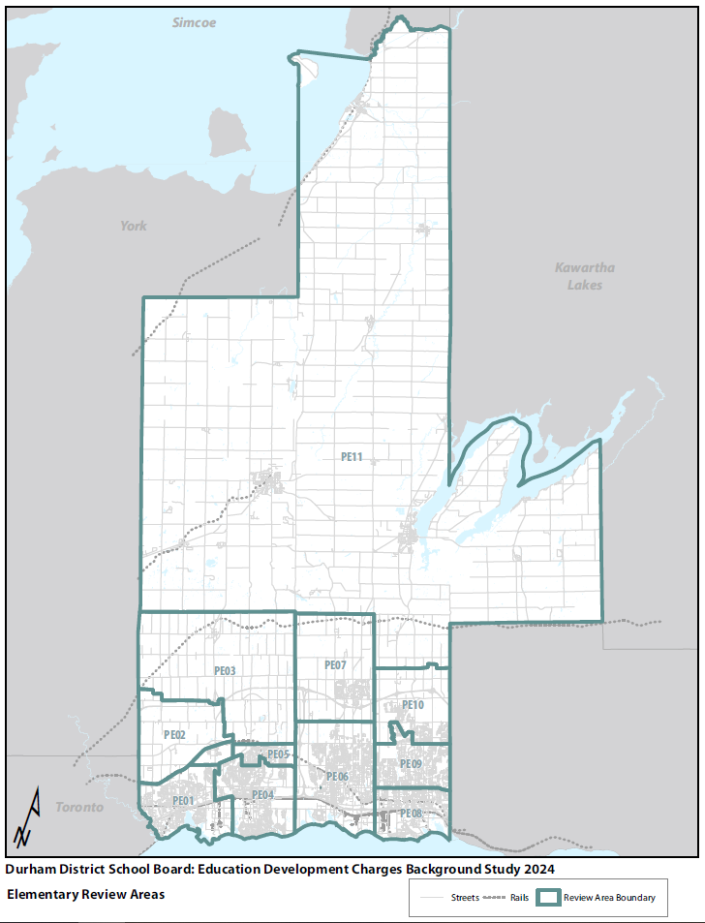
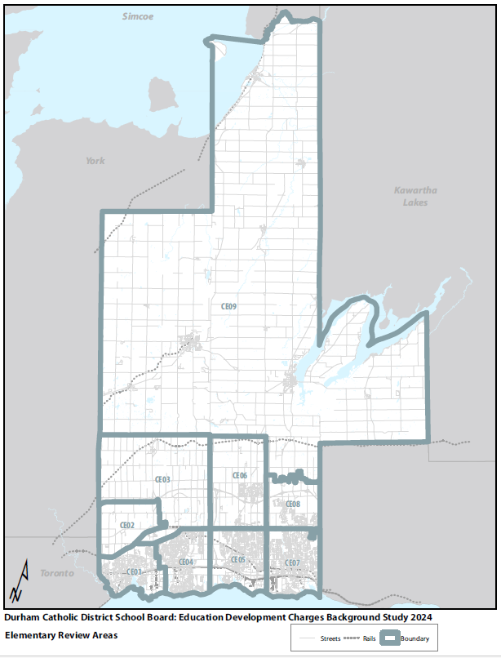
EDC Review Area Map – Elementary Panel
QUADRANT ADVISORY GROUP & PSTGI

Slide 5
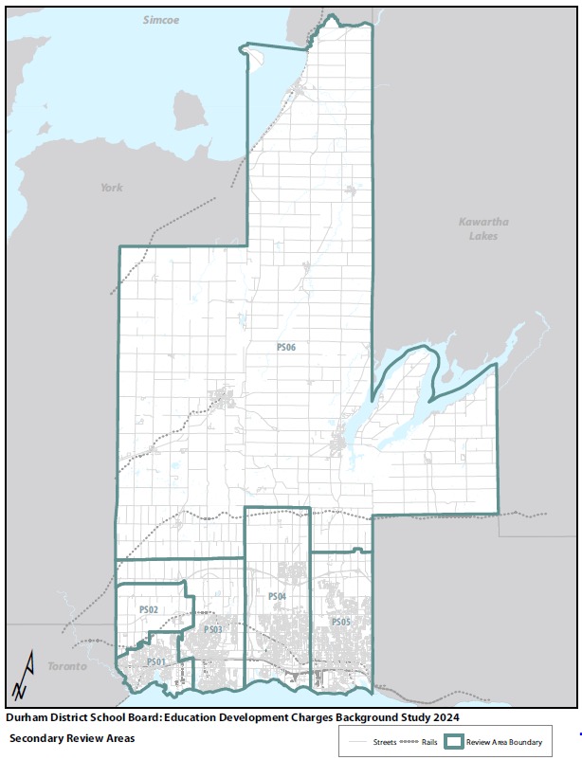
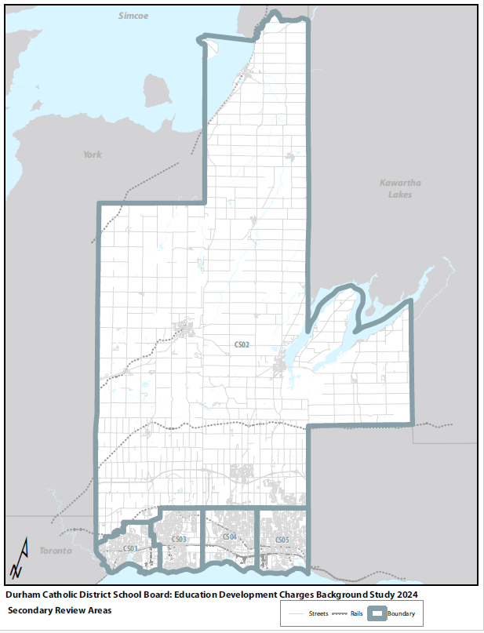
EDC Review Area Map – Secondary Panel
QUADRANT ADVISORY GROUP & PSTGI

Slide 6
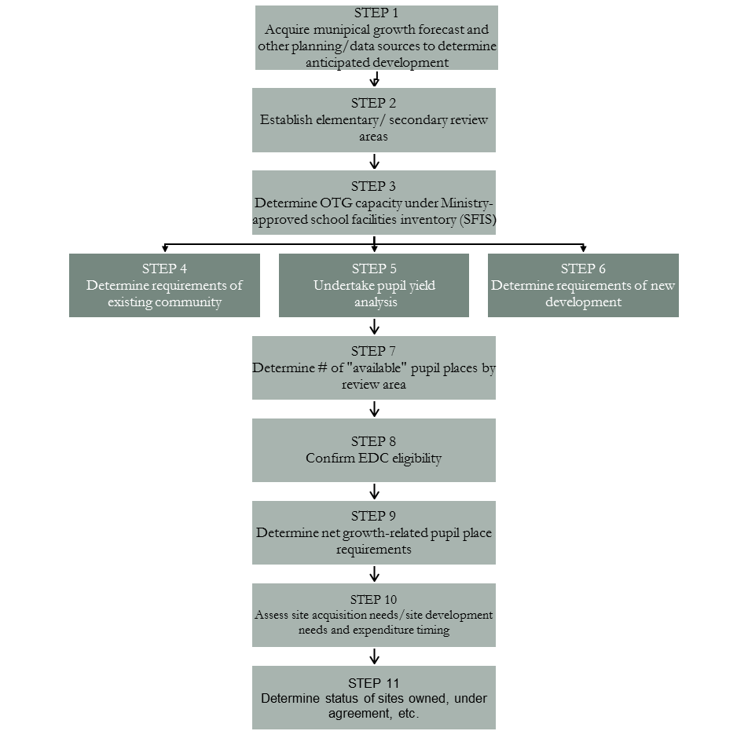
Education Development Charges Process
PLANNING COMPONENT
QUADRANT ADVISORY GROUP & PSTGI
FINANCIAL COMPONENT
STEP 1
Determine site acquisition costs
STEP 3
Escalate site acquisition / site development costs
STEP 2
Identify site development / study costs
STEP 4
Determine sources of funding to reduce the charge
STEP 5
Determine financial impact of expenditure program considering borrowing impact, interest earnings, etc.

Slide 7
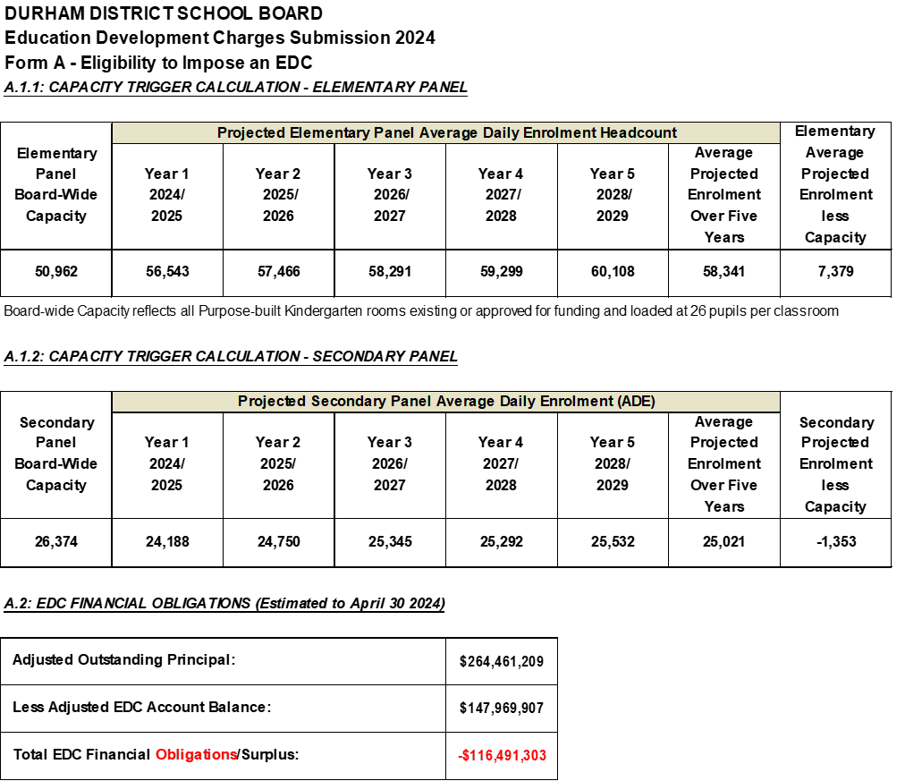
DDSB Qualifies to Adopt a Successor EDC By-law
The Board is expected to have a deficit of $116.4 million in the EDC account at successor by-law implementation.
The DDSB also qualifies to adopt a successor EDC by-law on the basis of elementary enrolment in excess of capacity
QUADRANT ADVISORY GROUP & PSTGI

Slide 8
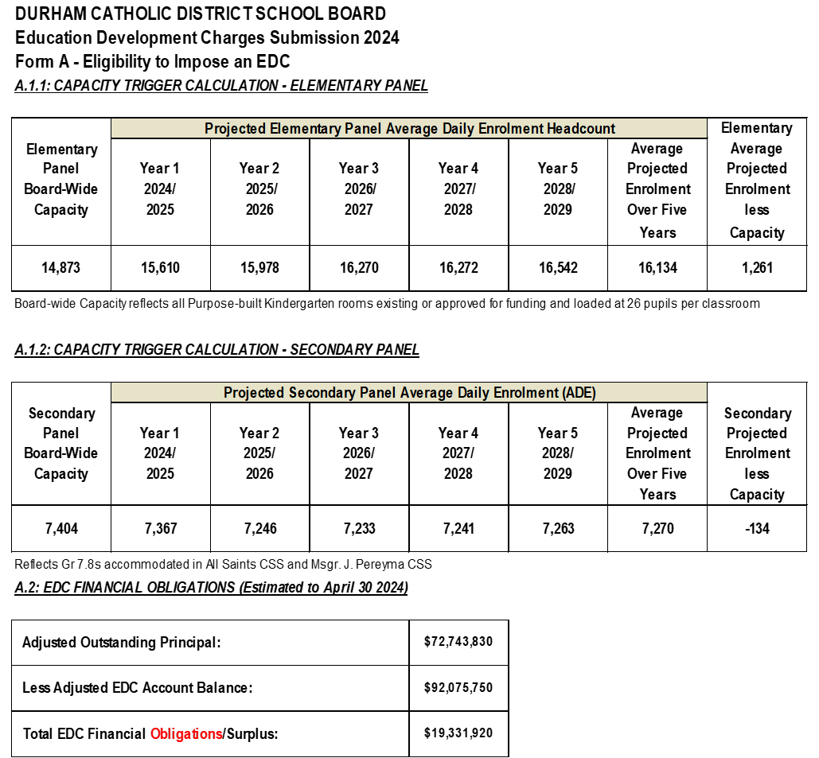
DCDSB Qualifies to Adopt a Successor EDC By-law
The DCDSB qualifies to adopt a successor EDC by-law on the basis of elementary enrolment in excess of capacity
QUADRANT ADVISORY GROUP & PSTGI

Slide 9
DDSB 15-YEAR EDC Projections
For the 2024/25 to 2038/39 forecast period, 94,223 new units and 45.7 sq ft of non-residential GFA
DDSB student data is spatially matched by elementary catchment area to MPAC data to determine the number of pupils per household that would be generated by the construction and occupancy of new homes, and would attend DDSB schools – pupil yields
The DDSB-specific & density-specific pupil yields are applied to the housing forecast to determine the Requirements of New Development (ROND)
QUADRANT ADVISORY GROUP & PSTGI
The ROND, when added to the Existing Community enrolments equals total projected enrolment over the 2024/25 to 2038/39 forecast period
Additional 17,903 elementary and 6,247 secondary pupils to be generated from 94,223 new dwellings.

Slide 10
DCDSB 15-YEAR EDC Projections
For the 2024/25 to 2038/39 forecast period, 94,223 new units and 45.7 sq ft of non-residential GFA
DCDSB student data is spatially matched by elementary catchment area to MPAC data to determine the number of pupils per household that would be generated by the construction and occupancy of new homes, and would attend DCDSB schools – pupil yields
The DCDSB-specific & density-specific pupil yields are applied to the housing forecast to determine the Requirements of New Development (ROND)
QUADRANT ADVISORY GROUP & PSTGI
The ROND, when added to the Existing Community enrolments equals total projected enrolment over the 2024/25 to 2038/39 forecast period
Additional 5,245 elementary and 2,080 secondary pupils to be generated from 94,223 new dwellings.

Slide 11
EDC-eligible Costs
Education Land Costs under section 257.53 (2) of the Education Act include costs to:
    acquire land or
    an interest in land (this could be a strata interest),
    including a leasehold interest,
    to be used by the board to provide pupil accommodation’
Education land costs exclude costs of any building to be used to provide pupil accommodation
Precedent established with funding of underground parking in select locations based on business case and stakeholder agreement in 2013
Legislation allows the use of EDC funds for construction costs under a Minister-approved Alternative Project
In any 5-year by-law period, EDC-eligible costs are tied to how much residential development is projected to take place. As the Board moves from one by-law period to another, the # of new residential units grows and the % EDC-eligible expenditures grows
QUADRANT ADVISORY GROUP & PSTGI

Slide 12
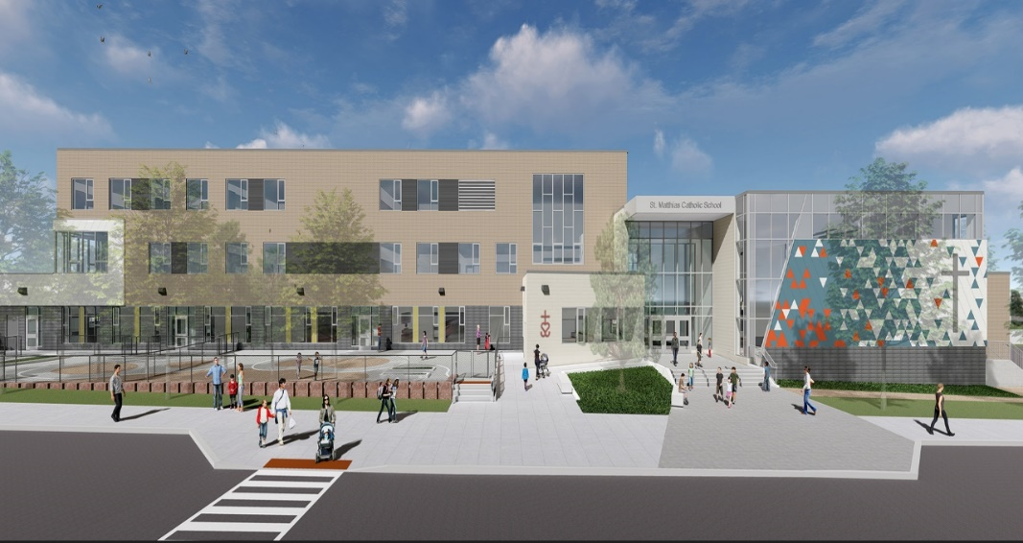
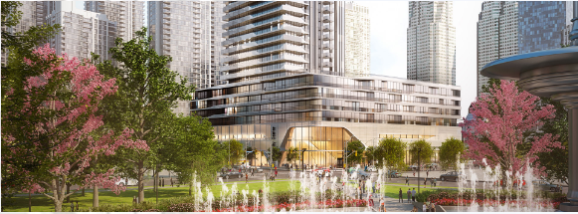
Alternative Projects Supporting Housing Affordability
STAND-ALONE SCHOOL SITE -
VERTICAL SCHOOL AS PART OF A PODIUM STRUCTURE -
QUADRANT ADVISORY GROUP & PSTGI
TCDSB St. Mathias CS - Snyder Architects
TDSB proposed elementary school Pinnacle One Yonge – Hariri Pontarini Architects
In 2018, the TCDSB proposed what has become Alternative Projects in the legislation as a means of supporting housing affordability
A Minister-approved Alternative Project must be less than the cost to acquire a conventional stand-alone school site
Alternative Project costs may include any or all of:
  portion of superstructure to accommodate the school;
  demising of the school portion of the superstructure to accommodate classrooms, admin space, gym, etc.
  School parking, drop-off, etc.;
  Share of nearby parkland to accommodate outdoor education programs

Slide 13
Growth-related Pupils to be Accommodated in Existing Capacity
For the Durham DSB more than 22% of the pupils to be generated from future housing development can be accommodated within available capacity
QUADRANT ADVISORY GROUP & PSTGI
For the Durham CDSB more than 30% of the pupils to be generated from future housing development can be accommodated within available capacity

Slide 14
DDSB Proposed Net Education Land Costs (NELC)
The EDC rates are spread over the net forecast (i.e., net of statutory exemptions)
A cashflow analysis is undertaken, for the purpose of:
Determining the appropriate ‘calculated rate;
Determine the potential funding shortfall to fund 100% of the growth-related school site needs, where the revenue stream is fixed under the legislative ‘cap’
For the DDSB, there is an additional funding requirement of $56 million after all available funding sources are
Considered. Currently, there is no funding source to cover the $56 million.
QUADRANT ADVISORY GROUP & PSTGI

Slide 15
DCDSB Proposed Net Education Land Costs (NELC)
The EDC rates are spread over the net forecast (i.e., net of statutory exemptions)
A cashflow analysis is undertaken, for the purpose of:
Determining the appropriate ‘calculated rate;
Determine the potential funding shortfall to fund 100% of the growth-related school site needs, where the revenue stream is fixed under the legislative ‘cap’
QUADRANT ADVISORY GROUP & PSTGI

Slide 16
DDSB EDC Proposed Rates
QUADRANT ADVISORY GROUP & PSTGI
The calculated rate is:
  $12,540 per residential dwelling unit, and;
  $2.14 per sq ft of non-residential GFA
  Based on the 94% residential and 6% non-residential shares if approved as the basis for the res/non-res share split
Consistent with the legislative ‘cap’ the residential rate will increase by $300 per unit until 2038/39 (provided that the ‘cap’ as currently structured remains in place), when the capped rate would equal the calculated rate, and provided the land value increases don’t exceed 5% per annum. The non-residential rate would increase by $0.10 per sq ft of GFA over the entire 15 year period and beyond to 2038/39.
The legislative capped rates will generate in the order of $528.8 million if the projection of new units and non-residential GFA is realized over the next 15 years.

Slide 17
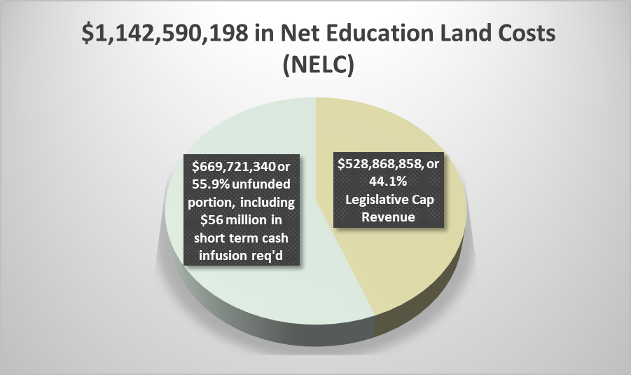
DDSB Financial Impacts
As the Durham DSB’s financial shortfall occurs well beyond the next 15 years, almost 56% of the net education land costs are unfunded , provided that cost do not increase beyond the escalation factors assumed
This makes the DDSB unique in that, while growth-related expenditures are expected to continue with housing growth beyond Year 15, the revenue stream will continue to be limited to the ‘cap’ until Years 24/25. An additional $56 million in funding is required by 2026/27, but there is no committed and available funding source at this time
Borrowing requirements $70 million, through an existing L/C, would be required immediately to fund a portion of the existing deficit, with $34.6 million in interest payments
Repayment of principal and interest would require $6.996 million, or in the order of 10% the revenue over the next 2 years
However, as the DDSB moves through another 3 by-law adoptions over next 15 years, and assuming the growth rates remain stable and costs don’t exceed the projected land and site preparation values, there would be an expectation of an additional $300 million in expenditures every by-law period, and for which there is no additional funding unless the cap is lifted
The EDC rates under various assumptions respecting residential and non-residential shares are shown to the left
QUADRANT ADVISORY GROUP & PSTGI

Slide 18
DCDSB EDC Proposed Rates
QUADRANT ADVISORY GROUP & PSTGI
The calculated rate is:
  $3,514 per residential dwelling unit, and;
  $0.60 per sq ft of non-residential GFA
  Based on the 94% residential and 6% non-residential shares if approved as the res/non-res share split
Consistent with the legislative ‘cap’ the residential rate will increase by $300 per unit until 2028/29 (provided that the ‘cap’ as currently structured remains in place), when the capped rate would equal the calculated rate. The non-residential rate would increase by $0.10 per sq ft of GFA until 2029/30.
The legislative capped rates will generate in the order of $306 million if the projection of new units and non-residential GFA is realized over the next 15 years

Slide 19
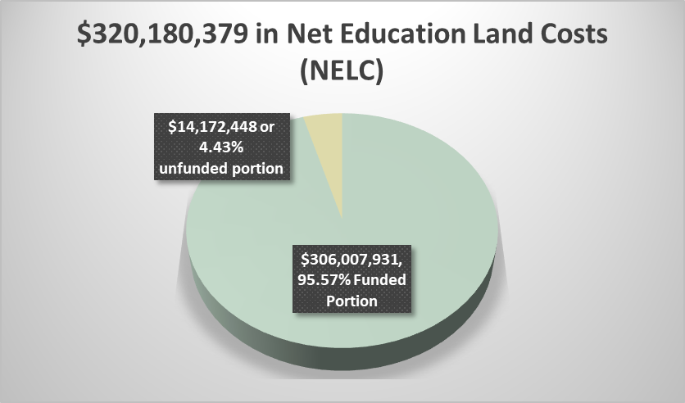
DCDSB Financial Impacts
As the Durham Catholic DSB’s financial shortfall only occurs in the first 4 years of the proposed by-law, only 4.43% of the net education land costs are unfunded , provided that costs do not increase beyond the escalation factors assumed
Borrowing requirements would be $87 million, through an existing L/C, with $33.2 million in interest payments
Repayment of principal and interest would require $6.3 million, or in the order of 30% the annual revenue
However, as the DCDSB moves through another 3 by-law adoptions over next 15 years, and assuming the legislative cap is not lifted and growth rates remain stable, there would be an expectation of an additional $100 million in expenditures every by-law period
Generally, the EDC rates under various assumptions respecting residential and non-residential shares are shown to the left
QUADRANT ADVISORY GROUP & PSTGI

Slide 20
Next Steps
DDSB By-law Adoption Public Meeting – Meeting #3 April 15, 2024
DCDSB By-law Adoption Public Meeting – Meeting #3 April 22, 2024
  Recommendations will be presented re: policy decisions and proposed EDC rates
  Trustees to consider adoption of by-law, following invitation for stakeholder input
  Provide municipal Building/Finance staff with updated EDC rates and any changes to by-law definitions and/or collections procedures
Publish Notice of By-law Passage in local newspaper no later than May 3rd; the last date for appeal is May 25th for the DDSB and June 1st for the DCDSB
QUADRANT ADVISORY GROUP & PSTGI

