Slide 1
DDSB FRENCH AS A SECOND LANGUAGE (FSL) REVIEW OF PROGRAMS
OCTOBER 2020
Notes:
We want to welcome you to the FSL Review of Programs Virtual Public Consultation Session.
We are truly living in unprecedented where were have had to learn new ways of being… so this is a first for me, and perhaps many of you… a session with over 1000 guests.
We thank you for taking the time out of your busy schedules to discuss the future of our French as a Second Language (FSL) at Durham District School Board
We have a short presentation that we would like to share with you to give you some context to our FSL programming here at DDSB.
Before we begin with our Land Acknowledgement, I want you to hold off on asking questions until the presentation has ended. You will have an opportunity to post your written questions in the Q and A box after the presentation. This will make it much easier for us to manage.

Slide 2
Land Acknowledgement
The Durham District School Board acknowledges that many Indigenous Nations have longstanding relationships, both historic and modern, with the territories upon which our school board and schools are located. ‎Today, this area is home to many Indigenous peoples from across Turtle Island. We acknowledge that the Durham Region forms a part of the traditional and treaty territory of the Mississaugas of Scugog Island First Nation, the Mississauga Peoples and the treaty territory of the Chippewas of Georgina Island First Nation. It is on these ancestral and treaty lands that we teach, learn and live.
Notes:
land acknowledgements are a necessary first step toward honouring the original occupants of this land . They also help us recognize and respect Indigenous peoples’ inherent kinship beliefs when it comes to the land, especially since those beliefs were restricted for so long.

Slide 3
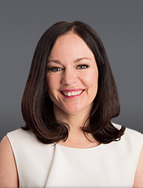
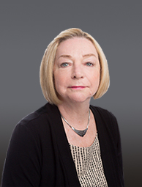
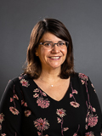
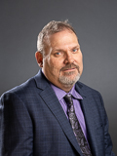
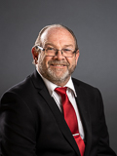
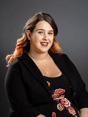
Trustees
Trustee Michael Barrett
City of Oshawa
Trustee Scott Templeton
Township of Whitby
Trustee Ashley Noble
City of Oshawa
Trustee Niki Lundquist
Township of Whitby
Trustee Christine Thatcher
Township of Whitby
Trustee Darlene Forbes
City of Oshawa
Notes:
We want to recognize our school trustees for Whitby and Oshawa
Whitby:
Trustee Niki Lundquist, Township of Whitby
Trustee Christine Thatcher, Township of Whitby
Trustee Scott Templeton, Township of Whitby
Trustee Michael Barrett, City of Oshawa
Trustee Darlene Forbes, City of Oshawa
Trustee Ashley Noble, City of Oshawa
The most important responsibility of school board Trustees is to work with their communities to improve student achievement all of our schools. ...
We value and welcome your presence with us tonight.

Slide 4
Ministry of Education Mandate for FSL
The Ontario Ministry of Education (2013a) describes the vision for French education as follows: Students in English-language school boards have the confidence and ability to use French effectively in their daily lives (p.8)
The Ministry of Education supports this vision with three goals:
Increase student confidence, proficiency, and achievement in French as a second language (FSL)
Increase the percentage of students studying FSL until graduation
Increase student, educator, parent, and community engagement in FSL
Notes:
Aligned with the overarching vision, three main goals to support this vision
Read them:
All decisions made for the French Department should be filtered through these three goals.

Slide 5
DDSB Models of FSL Programming
Core French
French Immersion
Mandatory from grades 4 – 8 for all students in English language schools
Students must accumulate a total of 600 hours by the end of grade 8
One mandatory core French credit required in Secondary School
Students may continue core French to the end of grade 12
Elementary core French enrolment remains steady, but drops significantly between Grades 9 and 10
More intense
Offered in single track and dual track schools
100% French instruction in grades 1-3
50% French instruction in grades 4-8
Students accumulate a minimum of 3800 hours by the end of grade 8
Students may continue with FI in secondary school and complete a total of 10 FI credits towards a French Immersion Certificate
Notes:
Student across Ontario commonly choose among three options: Core French, Extended French and French Immersion.
DDSB offers two models: Core French and French Immersion
Core French enrolment is compulsory in elementary grades and is usually offered in Grades 4-8.
Ontario students in Core French must have accumulated a minimum of 600 hours of French instruction by the end of Grade 8. One French credit for the Ontario Secondary School Diploma (OSSD) is mandatory. Students usually satisfy that requirement in Grade 9.
Students can take French as a subject from Grades 9 - 12.
Elementary school Core French enrolment remains steady but drops significantly between Grades 9 and 10. By grade 12, we have 90% attrition rate
FI is more intense. In FI, students learn French as a subject and French serves as the language of instruction in two or more other subjects.
In Ontario, FI students have accumulated a minimum of 3800 hours of French instruction by the end of Grade 8.
At the secondary level, FI students will acquire 10 credits in which French serves as the language of instruction: four are for FSL (language) courses, six are for other subjects. The school grants a certificate in French Immersion to students who complete the program at graduation.
Entry into FI programs has been rising steadily over the decades in Canada and in Ontario. However, by the end of grade 12, DDSB has an attrition rate of 85%
Within French Immersion, DDSB offers two models of delivery : dual track and single-track schools; 10 dual track elementary schools and 7 single track French Immersion elementary school. This year we have added the DDSB@Home French Immersion school. In the secondary panel there are 7 dual track secondary schools. There are no single track French immersion schools at the secondary level
Last year we had 28, 405 students in Core French and 13, 169 students in French Immersion Programs In our Board, French Immersion is open to all students who would like to be in the program: There is no cap or lottery – it is an open enrolment program

Slide 6
FSL Review of Programs - Why?
Comprehensive environmental scan of DDSB’s FSL programs: challenges and success
Overwhelming French Immersion enrolment has implications for the viability of English Language programs and for equity of education for all
Enrolment FI pressures in dual-track schools
A lack of qualified FSL teachers to meet the demands of enrolment
A scarcity of teaching tools and resources designed for diverse FSL learners
Notes:
why is the DDSB engaging in an FSL Review of its programs – we want to examine challenges and success of the two programs. We know that for organizations to flourish and for continual improve there must always be an process for self-reflection and self-assessment.
So we are conducting comprehensive environmental scan of our FSL programs: analysing data, looking at trends and pattern in DDSB and other boards, focus groups, surveys to identify program needs and recommend strategies for moving forward with improvements to our programs.
We will examine trends and patterns in enrolment, attrition, achievement,
FI Enrolment pressures in dual track school – English track greatly declining – splits through the grades, students moving through the grades with the same group of students, staffing pressured with declining enrolment; meanwhile FI growth contributes to issues of equity and inclusiveness
We also want to look at FSL attrition rates: in grade 9 core French last year we had an enrolment of 1385 students, but in grade12 of the same year the number of students completing core French was 439 – 90% attrition rate form the number of student who began grade 9 four years earlier The data for French immersion is similar: grade 1: 1056, Grade 8: 733 and by grade 12 we have 400 students. We want to explore the reasons for this attrition rate. And we know that you, perhaps, may be able to give us some insight into this aspect
We also experiencing enrolment pressures in dual track schools as enrolment In the English Stream is reduced due to the interest in French Immersion. As students leave SK, most parents are opting for the FI program in the school
Both core and FI programs are experiencing teacher shortage – this is an issue across the province and in Canada. It is not just a DDSB issue. Supply and demand is a huge issue. Some boards have limited capacity to access FI though various means: capping and lotteries
Other areas that the review will examine equity of access for all students: ELL, accommodating students with special needs - these leads nicely into our next slide

Slide 7
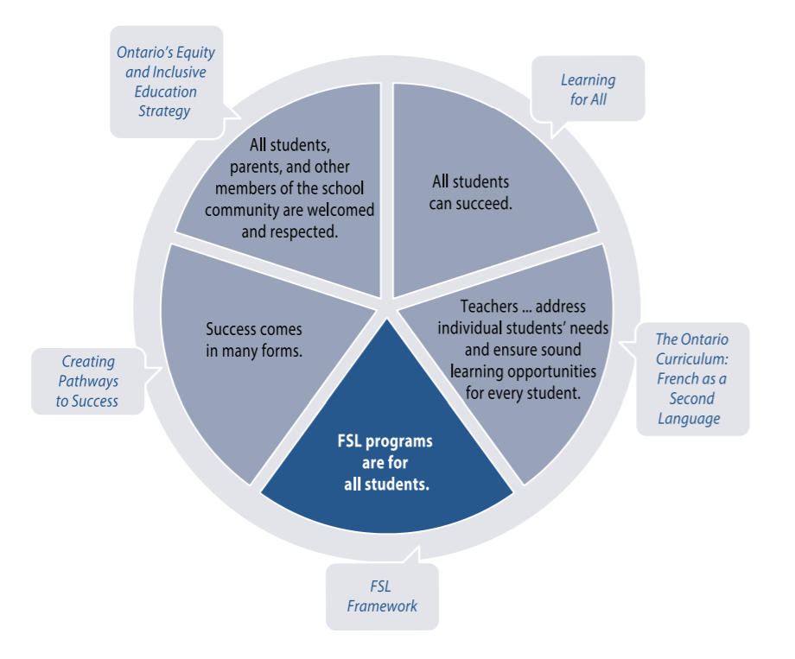
French for All
Notes:
FSL programs are for all students
The lack of students with special education needs and ELLs in French programs across Ontario promoted the Ministry of Education to address this in issue. In 2015, the Ontario Ministry of Education issued a report found in the document that you see on your screen as part of the Ministry’s ongoing commitment to strengthen FSL education with regards to inclusion of all students
19% student ID in all schools
6% in FI schools
25% in dual track schools
Dual Track FI schools have a disproportionally higher percentage of students with an IEP in the English program compared to the DDSB as a whole: 25% Dual Track English with IEP vs 19% DDSB English with IEP
Both DDSB as a whole and the Dual Track FI schools have a disproportionally higher percentage of students with IEP’s in the English program compared to the FI program: 13% more DDSB English students with an IEP than DDSB French Immersion students and 19% more Dual Track English students with an IEP than Dual Track French Immersion students
The foundation to these two documents is the knowledge, that:
All students can succeed
Teacher meeting individual student need in FSL as in other English subjects
Success comes in many forms – different pathways to success
Ontario’s equity plan – all students, parents and community members are welcomed and respected – this is extended to the curriculum as well

Slide 8
English Language Learners
“In the context of FSL, research confirms that a prior language learning experience can facilitate and accelerate further language learning. Indeed, many English language learners are motivated and able to excel in French, while in other areas of the curriculum, where their success may depend on their knowledge of English, the achievement gap between themselves and their peers may be much greater.”
The Ontario Curriculum, Grades 9 to 12: French as a Second Language (2014), p. 42
Notes:
The ministry also published a document Welcoming English Language Learners into FSL programs
The same premise applied to students with special needs applies in this case as well
We know that prior language learning can facilitate and accelerate further language learning
Many ELLs are motived and excel in FSL

Slide 9
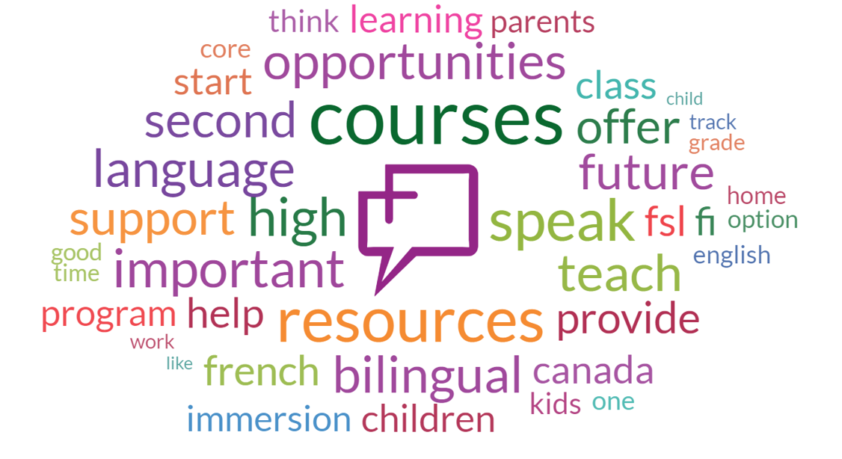
Community Word Cloud of All Thoughts
Notes:
WordCloud of all Thoughts by all Participants in Family Thoughtexchange
We conducted a community and family thoughtexchange which is crowdsourcing that helps us gather information from the community. Participants were asked to share their ideas in response to an open-ended question: Share your thoughts, ideas, and suggestions on how the DDSB can meet FSL programming needs while balancing the needs of all students for high quality inclusive education.
We had 3001 participants, 2,444 thoughts and 55, 736 star ratings. Once thoughts were shared, participants were asked to rate the thoughts that others provided on a scale of 1-5 stars based on how much they agreed with the ideas or how important they thought it was.
this graphic, a word cloud demonstrates for us the thoughts that came up frequently.
The larger the word, the more frequent the thought or idea. You can see from the graphic the variety of the words: courses – secondary, resources; speak,
The thoughtexchange gave us ideas of the concerns, issues, successes that the community values and the survey that will follow the two consultation sessions will allow you to dig deeper in these areas.

Slide 10
Community Thoughtexchange…You spoke!
Dual Track and Single Track
“French Immersion is a wonderful program. It needs to be immersed in a single stream Environment leaving no one disadvantaged.”
“Distribute the FSL students properly within each district, do not move English students from home schools to accommodate”
Core French
“…having the entire school for one French teacher is not productive. Consider a couple of teachers that split the job”
“special care should be taken to not overload FSL Classes with 30 students”
Notes:
Themes began to take shape as ideas were supported and these are some of the ideas that we have addressed already:
Dual track and single track
Then the English stream will not be ‘second place”, affecting such things as the student and teacher morale and classroom locations
Second bullet – this is important because students have a right to be in their home school, and not moved due to an optional FSL program”
Core French
Second quote: each student needs access to the teacher’s time and support

Slide 11
Community Thoughtexchange…You spoke!
Course Selection – Secondary FI
“FI Course selection is lacking for Grades 11 and 12 students”
Resources – Human
“attract and retain high quality French speaking teachers”
“the program is inferior to where it was in prior years”
Resources – Curriculum Supports
“leveled books made available in the classroom, provided by the board, so teachers have consistent resources to support the students”
“Resources for parents of FI students to prepare/support students”
Notes:
Course Selection
FI only to be told that school may not have enough FI credits to earn an FI diploma due to French course no longer being offered
Resources – Human
Students cannot become bilingual unless they have proper role models to emulate
Two FI children 8 years apart, the level of instruction and language has deteriorated across the board
Curriculum
LLI small group program in reading and writing help for French which is similarly offered in English; students in French need extra help just as the English students

Slide 12
Community Thoughtexchange…You spoke!
Equity of Access
“FI programs should be just as available and robust in marginalized and racialized communities”
“French should be introduced in Kindergarten programs”

Slide 13
Discussion Topics
FI Programs: Dual track and single track
Core French programming
Resource Implications
Human - Educators
Curriculum resources
Entry and Access to FSL Programs
Three guiding questions for each topic:
What are the successes and strengths of….?
Identify and describe the challenges, concerns and areas for improvement.
What suggestions do you have?

Slide 14
Thank You!
If you would like to give further input, several options are available:
Parent/Guardian Comprehensive Survey: Mid - October
email: fsl@ddsb.ca
Contact: 905-666-6092
Notes:
After our second Virtual Consultation on October 8th , you will receive a link to the YouTube presentation as well as a link to a survey that will give you further opportunity to express your opinion/address some of the issues that you heard here tonight.

