Slide 1
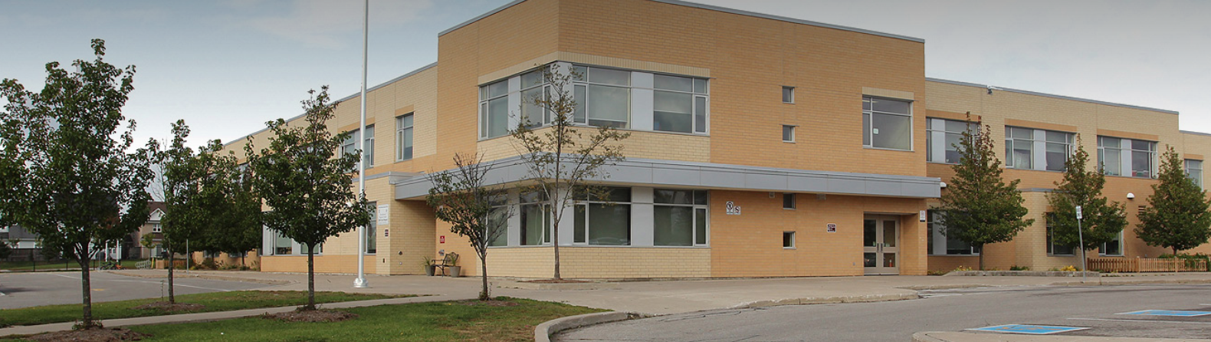
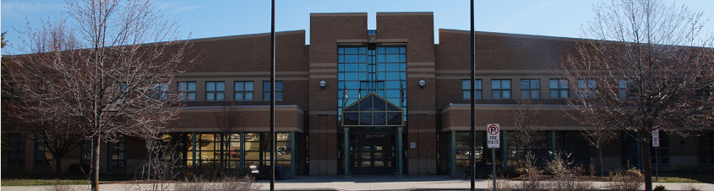
Education Development Charges Policy Review Public Meeting
QUADRANT ADVISORY GROUP & PSTGI
Durham DSB and Durham Catholic DSB
February 28, 2024

Slide 2
EEDC Policy Review
Durham DSB adopted a jurisdiction-wide EDC by-law on April 10, 2019 and Durham Catholic DSB on April 15, 2019; both with an implementation date of May 1, 2019
The current EDC by-laws will expire on April 30, 2024
Both by-laws reflected the legislative ‘capped’ rate provisions imposed by the province as of March 29, 2019
The legislative rate ‘cap’ limits the annual increase to $300 per residential unit and $0.10 per sq ft of non-residential GFA (5%)
Current EDC Rates:
DDSB - $3,449 per residential dwelling unit
DCDSB - $2,286 per residential dwelling unit
Successor by-laws must be adopted no later than April 26th to avoid any interruption in collection of EDCs (i.e. there is a 5-day waiting period prescribed in the legislation)
QUADRANT ADVISORY GROUP & PSTGI

Slide 3
EEDC Policy Review – Legislative Basis
EDCs are charges imposed by school boards on new residential and non-residential development (where applicable) at the building permit issuance
The funds collected may only be used by the Boards to acquire land needed to address growth-related student accommodation pressures in areas of new residential development. Eligible costs include the acquisition and the preparation of the land to make the site “building ready”. Eligible costs may also include an ‘interest in land’ if approved by the Minister of Education
Legislation requires that a board conduct a review of the existing EDC policies before passing a new EDC by-law – this meeting
Discussion of existing policies is set out in Appendix C of the February 13, 2024 EDC Background Study and Policy Review reports, which are posted to each Board’s website
QUADRANT ADVISORY GROUP & PSTGI

Slide 4
EDC Policy Review – Key Policies
By-law Structure
Considerations:
Boards may adopt jurisdiction-wide (i.e. one set of charges through all of the jurisdiction); or one or more area-specific by-laws (i.e. different rates in portions of the jurisdiction – i.e. a different rates in Pickering, Ajax, Whitby, Oshawa and Townships for example)
There is no financial advantage to the board, or to any particular municipality or community, in adopting area specific by-law structure and no EDC board has done so
The legislation does provide for ‘regional’ by-law structures (i.e. this is a regional by-law in that Clarington is excluded from the by-law jurisdiction)
The proposed JW by-law structure is based on area-specific land needs (i.e. review areas and portions of review areas) without the complication of AS by-laws
There are a number of disadvantages to adopting AS by-law structures including:
Development community stakeholders have consistently preferred the average costing approach inherent in the JW by-law structure – reduces potential for appeal
Risks of reduced recovery of growth-related costs where attendance boundaries and accommodation strategies change over time
AS structure would need to identify future new school boundaries over 15 years and ensure that there is no crossover between areas - secondary needs in particular are often attributable to development in multiple areas
Need Minister’s permission to spend funds collected in one by-law area, in another
QUADRANT ADVISORY GROUP & PSTGI

Slide 5
EDC Policy Review – Key Policies
By-law Structure – Disadvantages of AS By-law Structures
Multiple EDC accounts restrict ability to match timing and location of growth-related site needs
Monies collected in one area-specific by-law cannot be spent outside of that area, without advance permission of the Minister (as part of EDC Submission approval)
Cannot adopt separate by-laws for elementary and secondary needs in each AS area
Inconsistent with provincial policies supporting affordable housing
Could not easily move from AS structure to JW structure at a later date (legislation does not contemplate this)
Inability to have sufficient funds in AS account when required and no internal funding source to fund shortfall
Considerable potential to strand funds (if pupils are held in schools outside of the by-law area)
Exponential increase in administration of by-laws and no legislative guidance if later boards decide to revert to JW by-laws
A jurisdiction-wide by-law has been prepared for adoption based on the findings throughout the EDC Background study
QUADRANT ADVISORY GROUP & PSTGI

Slide 6
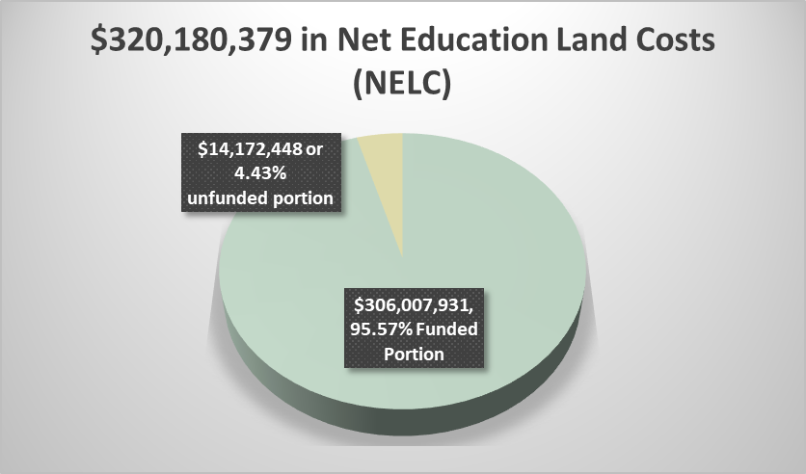
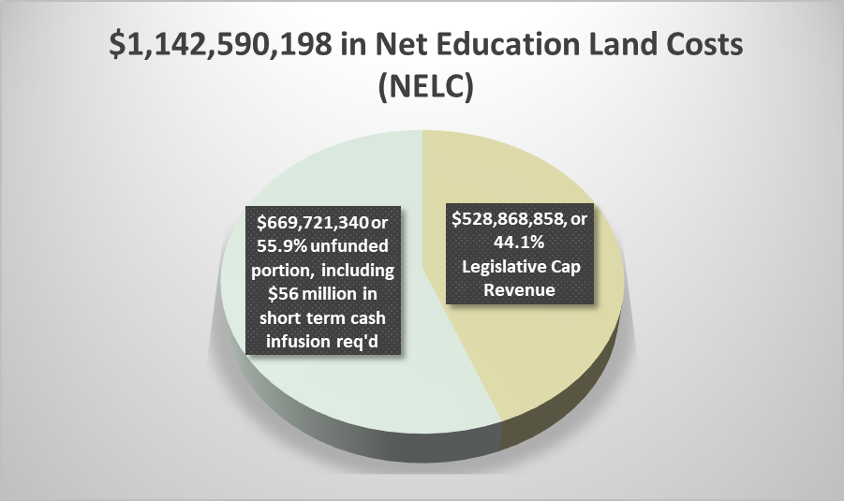
EDC Policy Review – Key Policies
Recovery of Net Education Land Costs
Considerations:
Prior to March 2019, all EDC by-laws in Ontario were structured on the basis of recovery of 100% of net education land costs over the long term (no more-no less than land acquisition and site development costs to address growth-related needs)
No tax-based funding source to make up for shortfalls
Capital allocations for land related to enrolment growth are not available from the Province where a school board is EDC eligible
In most jurisdictions, the legislative rate ‘cap’ restricts the ability to recover 100% of the net education land costs and the funding shortfall will continue to grow unless the cap is removed
An analysis was undertaken to determine the maximum revenue that could be derived under various iterations of residential and non-residential rates, in order to maximize recovery of net education land costs
The legislative ‘cap’ itself generates funding shortfalls of at minimum:
Durham Catholic DSB
QUADRANT ADVISORY GROUP & PSTGI
Durham DSB

Slide 7
EDC Policy Review – Key Policies
Non-Statutory Exemptions
Considerations:
No funding source to absorb the cost of providing non-statutory exemptions (e.g. affordable housing as a use)
EDC boards generally do not include non-statutory exemptions in their by-laws
Any post by-law adoption discretionary exemptions would require amendment to the by-law and must be applied consistently across the by-law area
More recent interpretation of statutory exemptions for secondary dwelling units would only apply to the principal residence
Portion of Net Education Land Costs to be Recovered from Residential versus Non-residential Development
Considerations:
Non-residential share can range from 0% to 40% of total costs
For most EDC by-laws 10-15% of costs are recovered from non-residential development, with the remainder from residential development
The Durham Boards currently recover 100% of net education land costs from residential development
QUADRANT ADVISORY GROUP & PSTGI

Slide 8
EDC Policy Review – Key Policies
Portion of Net Education Land Costs to be Recovered from Residential versus Non-residential Development cont’d
Considerations re maximizing recovery
of net education land costs should the
legislative rate ‘cap’ remain in place
A residential/non-residential share of
94-95% residential and 5-6%
non-residential would maximize short
and longer term recovery of net
education land costs
QUADRANT ADVISORY GROUP & PSTGI

Slide 9
EDC Policy Review – Key Policies
Differentiated EDC
Considerations:
Board may choose to have a singular EDC rate for all residential unit types, or differentiated by density type
EDC boards determine differentiated residential rates based on pupil generation per unit type, although alternative methodologies have been proposed, the Province has not implemented any changes as yet
Using pupil generation as the basis for differentiated charges makes the differential between low density and high density greater than DC differential
Stakeholders have historically preferred singular rate, consistent with averaging of costs and rates
Demolition Credits
Considerations:
Legislative provisions require Boards to provide demolition credits for a period of up to two (2) years for residential development and five (5) years for non-residential development
The Durham Boards EDC by-laws incorporates a 2-year grace period for residential
QUADRANT ADVISORY GROUP & PSTGI

Slide 10
EDC Policy Review – Key Policies
Conversion Credits
Considerations:
No legislative provisions specifically dealing with conversion of use
Some boards offer limited EDC conversion credits
The existing Durham EDC by-laws do provide for redevelopment credits; not conversion credits
By-law term
Considerations:
The maximum term of five-years is typically adopted
The Durham EDC by-laws carry a five-year term
Board can amend the by-law or pass a new one earlier, if necessary (ongoing monitoring to account for land cost increase)
Consistency with each Board’s capital planning process is a consideration
QUADRANT ADVISORY GROUP & PSTGI

Slide 11
EDC Policy Review – Key Policies
Alternative Accommodation Arrangements
Considerations:
Requirement that the Boards contemplate “arrangements” for both land and buildings, where feasible
Requirement that EDC boards develop criteria for evaluating potential Alternative Projects and meet with development community stakeholders to seek their input
While the requirement that a board adopt a policy respecting alternative accommodation arrangements has been removed from the legislation, the legislation still permits a landowner to provide land for a school site in lieu of EDC credits
Need to Conduct Further Public Meeting
Board must determine through resolution whether any additional public meetings are required
QUADRANT ADVISORY GROUP & PSTGI

Slide 12
EDC By-law Adoption Process – Next Steps
Stakeholder Sessions
EDC reports have been sent to Ministry and coterminous boards
Sent EDC reports to BILD Durham Chapter with request for meeting and to seek input re potential for future Alternative Projects
Meeting with municipalities to review by-law definitions and collections administration/reporting
Policy Review Public Meeting – Meeting #1 February 28, 2024
1st Successor By-law Public Meeting – Meeting #2 February 28, 2024
Presentation of EDC Background study approach and recommendations and EDC by-law.
Proposed EDC rates for Board consideration.
Inviting stakeholder input.
By-law Adoption Public Meeting – Meeting #3 April 15, 2024 for the DDSB and April 22, 2024 for the DCDSB
Recommendations will be presented re: policy decisions and proposed EDC rates.
Trustees to consider adoption of by-law, following invitation for stakeholder input.
Provide municipal Building/Finance staff with updated EDC rates and clarify by-law definitions
QUADRANT ADVISORY GROUP & PSTGI

