Slide 1


LUNCHROOM SUPERVISOR CONTRACT GUIDE

Slide 2
TWO TYPES OF CONTRACT PACKAGES
New Hire Package
If applicant has never worked for the DDSB at any location.
If applicant has not worked for DDSB in the last 6 months.
Click for New Hire Package →
https://spark.ddsb.ca/en/resourcesGeneral/Documents/On-Boarding/Lunchroom-Supervisors-for-Administrators/2025-2026-New-Hire-LRS-Complete-Package.pdf
Re-Hire Package
If applicant has worked for the DDSB within the last 6 months.
Click for Re-Hire Package →
https://www.ddsb.ca/en/resourcesGeneral/On-Boarding/Documents/Lunchroom-Supervisors/2025-2026-Returning-LRS-Complete-Package.pdf

Slide 3
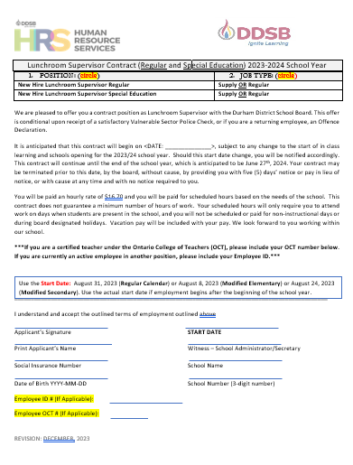
NEW HIRE - CONTRACT
NEW HIRE PACKAGE
EMPLOYMENT CONTRACT
1. Circle the Position on the left selecting Regular or Special Education.
2. Circle the Job Type on right selecting Supply or Regular.
3. Enter Start Date.
4. Applicant must complete the bottom left completely.
Ask if OCT Certified – Must provide OCT# if certified.
Ask if they have an employee ID # for an active position.
5. School Administrator/Secretary must fill in bottom right completely.
All Signatures must be present.

Slide 4
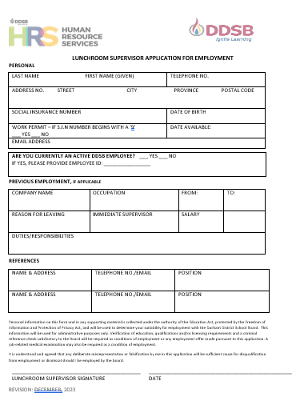
NEW HIRE - APPLICATION
NEW HIRE PACKAGE
EMPLOYMENT APPLICATION
Applicants must complete all areas CLEARLY and provide a valid e-mail address. An e-mail address is required, so that new hires can be provided with DDSB e-mail and log in information.
2. If Social Insurance Number begins with a “9”, a valid work permit MUST be submitted with onboarding documents.
Ensure legal name(s) are provided on all documents. Ex: If Catherine, do not enter Cathy.
Provide employee ID # if currently in an active position with the DDSB (if known).

Slide 5
NEW HIRE – OFFENCE DECLARATION
NEW HIRE PACKAGE
OFFENCE DECLARATION
1. Applicant must complete all areas on top portion.
2. Applicant must check appropriate box- either “Been convicted” or “Have not been convicted”.
If there are convictions, please list conviction(s), and provide brief details. People & Culture Department will review with applicant. Applicant CANNOT WORK until approved by People & Culture.
3. A receipt providing proof of application for a Vulnerable Sector Check MUST be attached to the Offence Declaration Form.
4. Form must be signed and dated.

Slide 6
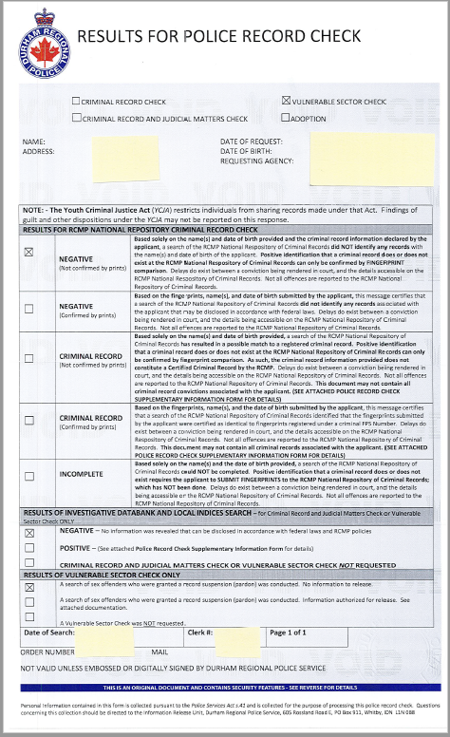
NEW HIRE – VULNERABLE SECTOR CHECK
NEW HIRE PACKAGE
VULNERABLE SECTOR CHECK
1. Applicant must submit a completed Vulnerable Sector Check from their local police department, no later than within six weeks of date of receipt.
A Criminal Check without the vulnerable sector screening will NOT be accepted.

Slide 7
NEW HIRE – DDSB BANKING FORM
NEW HIRE PACKAGE
DIRECT DEPOSIT BANKING FORM
1. Applicant to complete ALL areas CLEARLY.
2. Form must be signed and dated.
3. Void cheque or completed form from financial institution must be submitted on a separate page.
DO NOT cover the form with this information. This form provides legal authorization. If the bank account is in another name, other than the applicant, BOTH individuals must sign and date.

Slide 8
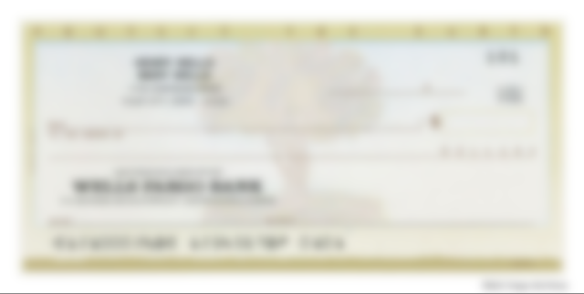

NEW HIRE – VOID CHEQUE
NEW HIRE PACKAGE
VOID CHEQUE/DIRECT DEPOSIT FORM FROM FINANCIAL INSTITUTION
Applicant MUST provide a void cheque OR a direct deposit form from their financial institution. For security and accuracy, all banking details must be submitted through either of these documents.
This must be attached to the DDSB direct deposit banking information form.

Slide 9










NEW HIRE – FEDERAL TAX FORM
NEW HIRE PACKAGE
FEDERAL TAX FORM (TD1)
Applicants must complete all highlighted areas on the TD1 form
Form must be signed and dated.

Slide 10



NEW HIRE – PROVINCIAL TAX FORM
NEW HIRE PACKAGE
PROVINCIAL TAX FORM (TD1ON)
Applicants must complete all highlighted areas on the TD1ON form
Form must be signed and dated

Slide 11
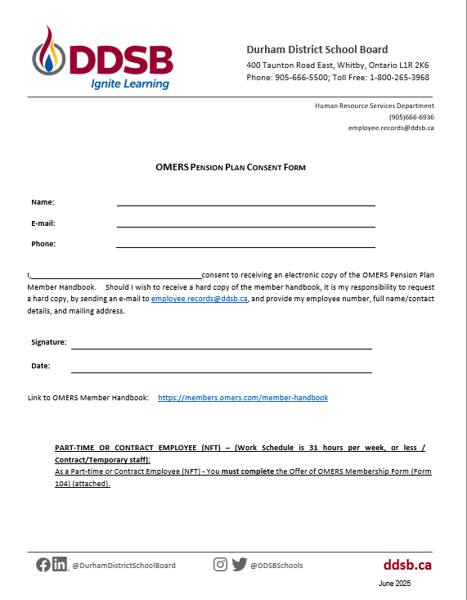
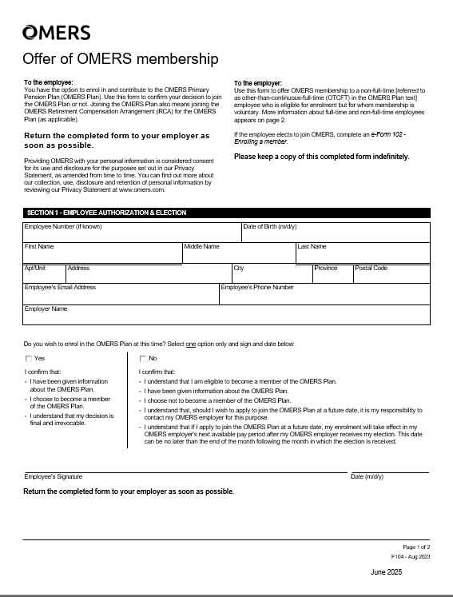
NEW HIRE PACKAGE
OMERS PACKAGE
OMERS CONSENT FORM
Complete, sign and date OMERS Pension Plan Consent Form
Complete Section 1: Employee Authorization and Election of the Offer of OMERS Membership
3. Applicants must check appropriate box – either Yes or No
Both forms must be completed by all Lunchroom Supervisors

Slide 12
NEW HIRE - CHECKLIST
NEW HIRE PACKAGE
CHECKLIST
The checklist included in the package does not need to be submitted. This is a guide to ensure all required documents have been completed and are ready to submit.
Once you have confirmed accuracy and completion of all documents, e-mail the completed package to hr.services@ddsb.ca
Send one package per email.
Applicant’s full name must be in the subject line of the email. E.g. New LRS Package: John Smith

Slide 13
RE-HIRE CONTRACT
RE-HIRE PACKAGE
EMPLOYMENT CONTRACT
1. Circle the Position on the left selecting Regular or Special Education.
2. Circle the Job Type on right selecting Supply or Regular.
3. Enter Start Date.
4. Employee must complete the bottom left completely.
If OCT Certified – Must provide OCT#
Provide Employee ID#
5. School Administrator/Secretary must fill in bottom right completely.
All Signatures must be present.

Slide 14
RE-HIRE – OFFENCE DECLARATION
RE-HIRE PACKAGE
OFFENCE DECLARATION
1. Must be completed every school year.
2. Employee must complete all areas in top portion CLEARLY.
3. Employee must check appropriate box- either “Been convicted” or “Have not been convicted”.
If there is a new conviction to report, it must be declared and listed. People & Culture will review with employee. Employee CANNOT WORK until approved by People & Culture Department.
4. Form must be signed and dated.

Slide 15
RE-HIRE PACKAGE
OMERS PACKAGE
OMERS CONSENT FORM
Applicants must complete, sign and date OMERS Pension Plan Consent Form
All Applicants must Complete Section 1: Employee Authorization and Election of the Offer of OMERS Membership
3. Applicants must check appropriate box – either Yes or No
Both forms must be completed by all Lunchroom Supervisors

Slide 16
RE-HIRE - CHECKLIST
RE-HIRE PACKAGE
CHECKLIST
The checklist included in the package does not need to be submitted. This is a guide to ensure all required documents have been completed and are ready to submit.
Once you have confirmed accuracy and completion of all documents, e-mail the completed package to hr.services@ddsb.ca
Send one package per email.
Applicant’s full name must be in the subject line of the email. E.g. New LRS Package: John Smith

Slide 17
ADDITIONAL INFORMATION
Enter Timesheets: https://spark.ddsb.ca/en/resourcesGeneral/Documents/On-Boarding/Lunchroom-Supervisors-for-Administrators/Entering-and-Approving-Timesheets.pdf
Durham Regional Police Vulnerable Sector Check: https://www.drps.ca/online-services/police-records/police-record-checks/
Pay Schedules: https://www.ddsb.ca/en/on-boarding-lunchroom-supervisors.aspx
Allocation Inquiries: Please contact your System Lead
Special Education Allocation Inquiries: Please contact Inclusive Student Services

Slide 18


CONTACTS
PEOPLE & CULTURE /HR SERVICES
Contracts and General Inquiries
905-666-6936
Hr.services@ddsb.ca
PAYROLL
Timesheets and Pay Inquiries
Voleen Campell
905-666-6327
voleen.campbell@ddsb.ca

